Slide 1
HashMap
The HashMap class uses a hash table to implement the Map interface. This allows the execution time of basic operations, such as get() and put(), to remain constant even for large sets.
The following constructors are defined:
HashMap( )
HashMap(Map m)
HashMap(int capacity)
HashMap(int capacity, float fillRatio)
The first form constructs a default hash map.
The second form initializes the hash map by using the elements of m.
The third form initializes the capacity of the hash map to capacity.
The fourth form initializes both the capacity and fill ratio of the hash map by using its arguments.
The meaning of capacity and fill ratio is the same as for HashSet, described earlier.
HashMap implements Map and extends AbstractMap. It does not add any methods of its own. You should note that a hash map does not guarantee the order of its elements. Therefore, the order in which elements are added to a hash map is not necessarily the order in which they are read by an iterator.

Slide 2
HashMap
public static void main(String[] args)
{
Map hMap = new HashMap();
// to add values
hMap.put("1", "One");
hMap.put("2", "Two");
hMap.put("3", "Three");
Set st = hMap.entrySet();
Iterator itr = st.iterator();
// to display
while (itr.hasNext()) {
Map.Entry entry = (Map.Entry) itr.next();
System.
out.println(entry.getKey() + " -- " + entry.getValue());
}
// to update on a specific key ex "1"
Integer refInt = new Integer(123);
hMap.put("1", refInt);
refInt = (Integer) hMap.get("1");
int i = refInt.intValue();
}
// to Check if exist
System.out.println(hMap.containsValue("Two"));
System.out.println(hMap.containsKey("2"));
// to remove
Object obj = hMap.remove("2");
System.out.println(obj + " Removed from HashMap");
//Check if a particular value exists in HashMap
System.out.println(hMap.containsValue("Two"));
System.out.println(hMap.containsKey("2"));

Slide 3
HashMap
import java.util.*;
class HashMapDemo {
public static void main(String args[]) {
// Create a hash map
HashMap hm = new HashMap();
// Put elements to the map
hm.put("John Doe", new Double(3434.34));
hm.put("Tom Smith", new Double(123.22));
hm.put("Jane Baker", new Double(1378.00));
hm.put("Todd Hall", new Double(99.22));
hm.put("Ralph Smith", new Double(-19.08));
// Get a set of the entries
Set set = hm.entrySet();
// Get an iterator
Iterator i = set.iterator();
// Display elements
while(i.hasNext()) {
Map.Entry me = (Map.Entry)i.next();
System.out.print(me.getKey() + ": ");
System.out.println(me.getValue());
}
System.out.println();
// Deposit 1000 into John Doe's account
double balance = ((Double)hm.get("John Doe")).doubleValue();
hm.put("John Doe", new Double(balance + 1000));
System.out.println("John Doe's new balance: " +
hm.get("John Doe"));
}
}

Slide 4
Output from this program is shown here:
Ralph Smith: -19.08
Tom Smith: 123.22
John Doe: 3434.34
Todd Hall: 99.22
Jane Baker: 1378.0
John Doe's current balance: 4434.34
The program begins by creating a hash map and then adds the mapping of names to balances.
Next, the contents of the map are displayed by using a set-view, obtained by calling entrySet().
The keys and values are displayed by calling the getKey() and getValue() methods that are defined by Map.Entry. Pay close attention to how the deposit is made into John Doe's account.
The put() method automatically replaces any preexisting value that is associated with the specified key with the new value.
Thus, after John Doe's account is updated, the hash map will still contain just one "John Doe" account.

Slide 5
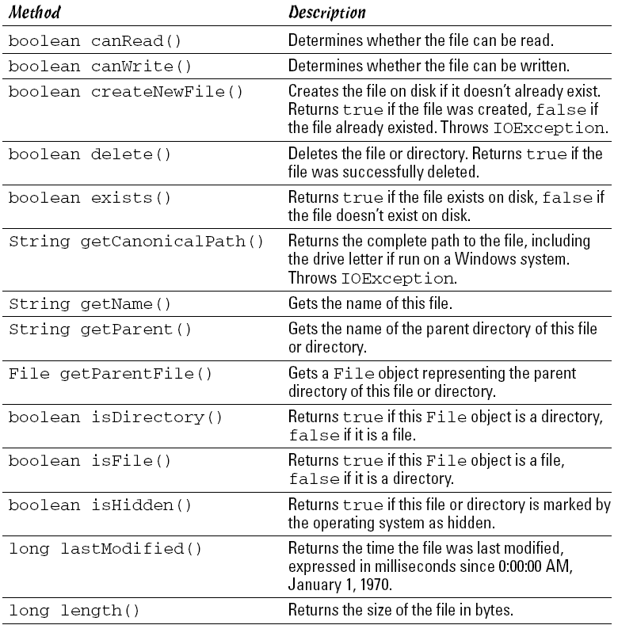
Using the File Class

Slide 6
String path = “c:\\logs\\hits.log”;
Creating a File object doesn’t create a file on disk. Instead, it creates an
in-memory object that represents a file or directory that may or may not
actually exist on disk. To find out if the file or directory exists, you can use
the exists method. For example:
File f = new File(path);
if (!f.exists())
System.out.println(“The input file does not
exist!”);
Here, an error message is displayed on the console if the file doesn’t exist.
To create a new file on disk, first create a File object with the filename you
want to use. Then, use the createNewFile method, like this:
File f = new File(path);
if (f.createNewFile())
System.out.println(“File created.”);
else
System.out.println(“File could not be created.”);
Note that the createNewFile method returns a boolean that indicates
whether or not the file was successfully created. If the file already exists,
createNewFile returns false, so you don’t have to use the exists
method before you call createNewFile.

